Slide 1
The Importance of Computer Networking in Cybersecurity
Done by: Sanada Thomas

Slide 2

Welcome:
Objectives:
Computer networking and its importance in cybersecurity.
Different types of networks
Different network topologies
Purpose and function of networking devices
Importance of Networking in Cybersecurity
A breakdown of Part 2: Application (scenario).

Slide 3
I. Computer Networking and its Importance in Cyber Security
Computer networking is a process of interconnecting two or more computer devices to share resources and data. It is a critical component of today's technological world, enabling individuals and organizations to communicate and share information effectively. However, it is also an essential component of cybersecurity, as the interconnected nature of computer networks can create security vulnerabilities. Cybersecurity refers to the practices, technologies, and processes that protect computer networks and data from unauthorized access, use, disclosure, disruption, modification, or destruction. The importance of computer networking in cybersecurity can be attributed to the following reasons:

Slide 4

Increased Attack Surface: As computer networks grow larger and more complex, their attack surface also increases, providing cybercriminals with more opportunities to exploit vulnerabilities.
Network Segmentation: Computer networking enables organizations to segment their networks, allowing them to control and monitor access to different areas of their network, reducing the risk of unauthorized access.
Monitoring and Detection: Computer networking allows organizations to monitor their network traffic and detect any suspicious or malicious activity, enabling them to respond promptly to any cybersecurity incidents.
Incident Response: In the event of a cybersecurity incident, computer networking can enable organizations to isolate the affected areas of their network and limit the damage.

Slide 5
Types of Networks:

Slide 6
Types of Networks:
Local Area Network (LAN): A LAN is a network that connects computers within a limited geographical area, such as a building or campus.
Wide Area Network (WAN): A WAN is a network that connects computers across a wide geographical area, such as a country or the world.

Slide 7
Types of Networks:
Metropolitan Area Network (MAN): A MAN is a network that connects computers within a metropolitan area, such as a city.
Wireless Local Area Network (WLAN): A WLAN is a wireless network that connects devices within a limited geographical area, such as a building or campus.

Slide 8
Types of Networks:
Personal Area Network (PAN): A PAN is a network that connects devices within a single person's workspace, such as a home office.

Slide 9
Network Topologies

Slide 10
Network Topologies:
Star Topology: In a star topology, all devices are connected to a central hub or switch.
Bus Topology: In a bus topology, all devices are connected to a single cable or a backbone.

Slide 11
Network Topologies:
Ring Topology: In a ring topology, devices are connected in a circular or ring-shaped manner.
Mesh Topology: In a mesh topology, devices are connected to multiple other devices, creating a network of interconnected nodes.

Slide 12
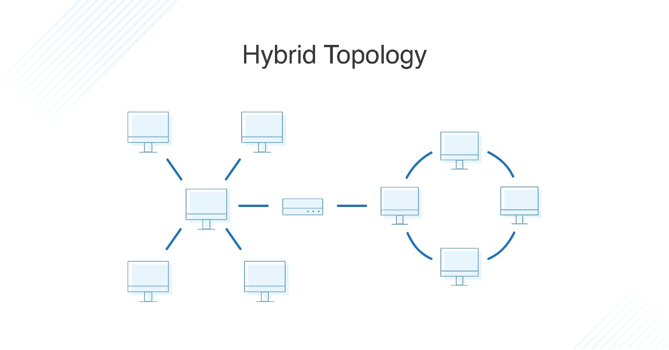
Network Topologies:
Hybrid Topology: A hybrid topology is a combination of two or more topologies.

Slide 13
Networking Devices

Slide 14
Network devices are physical devices that enable communication and interaction between hardware on a computer network.
Routers are networking devices that connect multiple networks and route data packets between them.
Switches are networking devices that connect devices within a network and enable them to communicate with one another.

Slide 15
Hubs are networking devices that enable devices within a network to communicate with one another.
Firewalls are networking devices that protect networks from unauthorized access by filtering incoming and outgoing traffic.

Slide 16
Importance of Networking in Cybersecurity

Slide 17
Computer networking is essential to cybersecurity because it allows different devices to communicate with each other and share information. However, this also creates opportunities for attackers to gain unauthorized access, steal data, or disrupt services. As a result, networking devices play a critical role in enhancing security and protecting against cyber threats.

Slide 18
Networking devices can be used to enhance security in several ways. For example, firewalls can be used to filter incoming and outgoing traffic based on a set of predefined rules, which can help to block unauthorized access and prevent malware from infecting systems. Intrusion detection systems (IDS) can be deployed to monitor network traffic and detect suspicious activity, such as attempts to access restricted resources or data.

Slide 19
Conclusion:
In conclusion, computer networking is a critical aspect of cyber security. Understanding the different types of networks, network topologies, and networking devices can help organizations build secure network infrastructures that protect their data from unauthorized access.

